Slide 1
EMPLOYEE PERFORMANCE ANALYSIS USING EXCEL
STUDENT NAME : SANJANA. G
REGISTER NO : 312209232 {asunm1353312209232}
DEPARTMENT : B.COM BANKMANAGEMENT
COLLEGE : ANNA ADARSH COLLEGE FOR WOMEN

Slide 2
PROJECT TITLE
Employee
Salary and Bonus Analysis using Excel

Slide 3
AGENDA
Problem statement
Project overview
End users
Our solution and proposition
Dataset description
Modelling approach
Results and discussion
Conclusion

Slide 4

PROBLEM STATEMENT
OBJECTIVE: To analyze and visualize the distribution of bonuses across different management levels (Junior, and Senior) within the organization. The goal is to identify patterns in bonus allocation, such as whether senior management receives significantly higher bonuses or if there are disparities in bonus distribution across management levels.

Slide 5

PROJECT OVERVIEW
SCOPE: This project will focus on exploring the relationship between management level and bonuses by Visualizing the distribution of bonuses across different management levels. Comparing how bonus amounts vary between Junior, and Senior levels. Identifying any potential disparities in bonus allocation across management hierarchies. Suggesting actionable insights based on findings, which could help inform HR policies, employee retention strategies, and compensation planning.

Slide 6



PROJECT OVERVIEW
DATA USED:
Salary: The base pay of each employee.
Bonus: The incentive/bonus paid to employees.
Department: The department each employee belongs to.
Management Level: The hierarchical position of the employee (Junior,Senior).

Slide 7












PROJECT OVERVIEW
DATA COLLECETION
DATA PREPARATION
DATA ANALYSIS
VISUALIZATION
INTERPRETATION
RECOMMENDATION

Slide 8
WHO ARE THE END USERS?
HERE’S THE LIST OF END USERS:
1. Human Resources (HR) Department
2. Compensation and Benefits Team
3. Senior Management / Executives
4. Finance Department
5. Department Heads/Managers
6. Employee Relations Team
7. Legal/Compliance Team
8. Employees (Indirect Users)

Slide 9
OUR SOLUTION AND ITS VALUE PROPOSITION
SOLUTION:
The solution involves conducting a detailed analysis of the bonus distribution across different management levels (Junior, Senior) within the organization. Using tools like histograms and data visualization, the analysis will uncover patterns, disparities, or trends in bonus allocation. The findings will help the organization optimize and align bonus distribution with performance, fairness, and overall business goals.

Slide 10
OUR SOLUTION AND ITS VALUE PROPOSITION
VALUE PROPOSITION:
Fair Compensation Practices: Identifies and addresses discrepancies in bonus distribution, ensuring equitable reward systems across different management levels.
Enhanced Employee Retention: By aligning bonus policies with employee performance and fairness, the organization can improve employee satisfaction and retention.
Informed Decision-Making: Senior management and HR can make data-driven decisions about compensation policies, helping to attract and retain top talent.
Budget Optimization: Provides insights that help the finance team allocate bonuses efficiently while maintaining financial sustainability.
Improved Employee Engagement: Transparent and fair bonus distribution boosts employee morale, motivation, and productivity.
Compliance and Legal Assurance: Ensures that compensation practices align with legal requirements and company policies, reducing the risk of legal disputes.

Slide 11
Dataset Description
The dataset used for the analysis includes the following key variables:
DATASET : KAGGLE FEATURES: 6 1: EMPLOYEE NAME-TEXT 2: GENDER-FEMALE, MALE 3: SALARY-NUMERIC 4: BONUS-NUMERIC 5: DEPARTMENT-TEXT 6: MANAGEMENT LEVEL-TEXT
11

Slide 12
THE "WOW" IN OUR SOLUTION
IFS(A2 > 80000, "High", A2 > 50000, "Medium", TRUE, "Low"). IF(A2="Manager", "Director", A2). REPLACE(old_text, start_num, num_chars, new_text).
12

Slide 13
MODELLING
DATASET : dataset is taken from Kaggle.com, the name of the dataset is employee bonus and salary information. Data is downloaded in excel. FILTERATION: The data is filtered thorough filtering formula. ANALYSIS: The data is analysed through various tools. SUMMARY: The data is summarized through pivot table.
PRESENTATION: The data is presented by pivot table and various charts like pie chart, bar chart, histogram, and heat map , etc,..
13

Slide 14
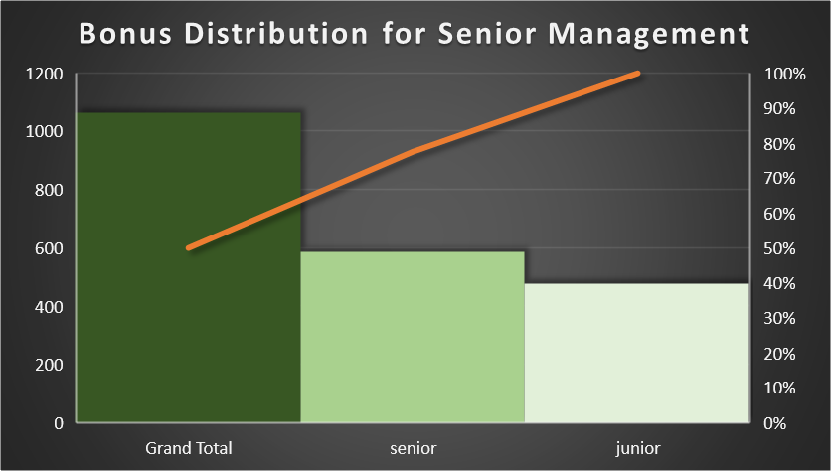
RESULTS
14

Slide 15
RESULTS
HEAT MAP
15

Slide 16
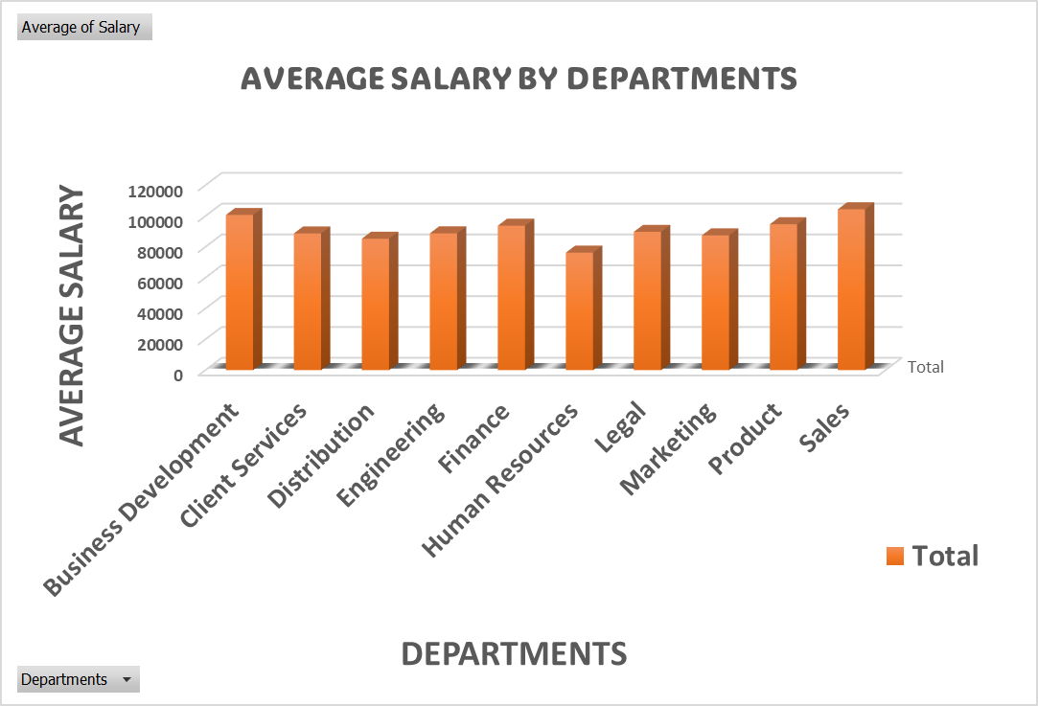
RESULTS
16

Slide 17
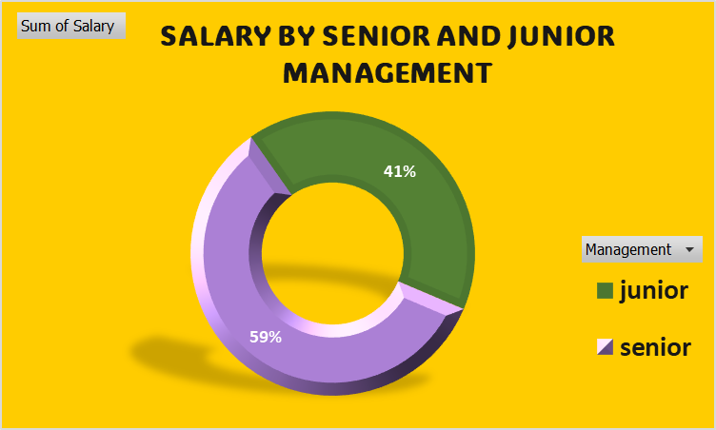
RESULTS
17

Slide 18
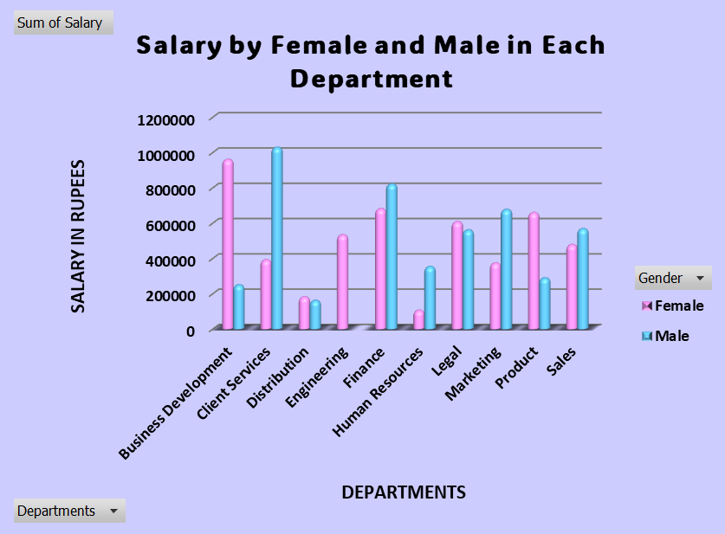
RESULTS
18

Slide 19
conclusion
The bonus distribution analysis reveals key insights into fairness and trends across management levels. By using statistical and visual methods, we can:
Ensure Fairness: Identify and address disparities in bonus allocation.
Spot Trends: Visualize patterns to guide adjustments.
Make Informed Decisions: Use data-driven insights for better compensation policies.
Plan Ahead: Forecast future bonus distributions for effective budgeting.
Tailor Strategies: Develop targeted compensation plans based on employee groups.
This approach ensures a fair, transparent, and strategic bonus distribution system.
19

